Slide 1


PEMANTAPAN MQF
Mohan Palaniandy
SU Jawatankuasa Dokumentasi MQF
IPGK IPOH

Slide 2
Apa & Mengapa MQR/MQF/MQA
Memahami Konsep MQR
Apa kaitan dengan MQA
Memahami konsep MQF

Slide 3
TUGAS/PERANAN PELAJAR
1. Memahami MQF/MQA dan COPPA
2. Memahami konsep penting dalam Program
Program Education Objectives (PEO)
Program Learning Outcome (PLO)
Course Learning Outcome (CLO)
Topic Learning Outcome (TLO)
- SLT (Student Learning Time)
- ISL (Independent student learning)
- Program
- Kursus (subject)
- Kredit dan kiraan jam
- Notional Hours
- MQF dan MQA (malaysian Qualifications Framework)
3. Menyediakan Fail Kursus

Slide 4
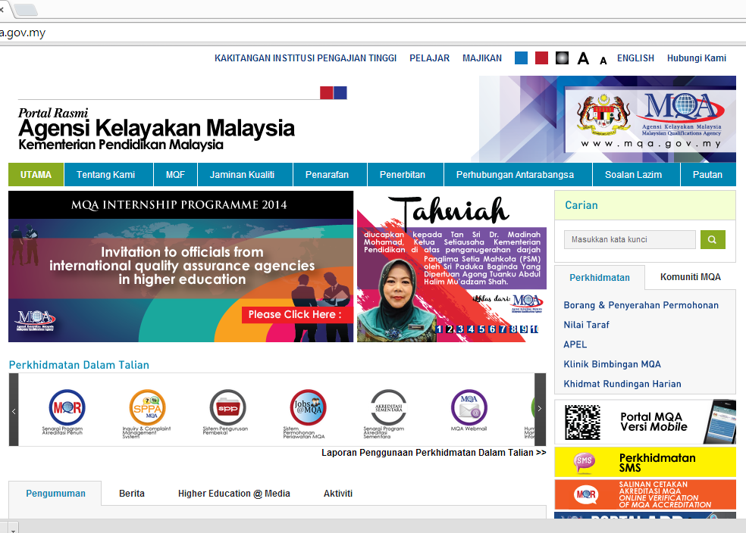

Slide 5
AKTA MQA-PERUBAHAN PENTING
Keseragaman sistem jaminan kualiti dan kelayakan
Memastikan kelayakan yang diakreditkan mudah diiktiraf di peringkat antarabangsa
Memberi peluang pembelajaran sepanjang hayat
Memfokus kepada penambahbaikan kualiti institusi
Melaksanakan akreditasi program => secara sukarela di bawah Akta MQA
Audit institusi
Swaakreditasi

Slide 6
Accreditation status by MQA has many advantages. Besides being a benchmark for quality programme, it also has other advantages such as:-
i. Students are eligible to apply for loan from funding agencies such as National Higher Education Fund (PTPTN).
ii. Students are eligible to continue their studies in higher education institutions and obtain credit transfer. However, the final decision lies with the institution concerned.
iii. Students can be considered for employment in the public sector. In many cases, even private sector employer consider accredited programmes in their selection of graduates for employment.
iv. Institutions can franchise their accredited programmes to other institutions, subject to certain conditions.

Slide 7
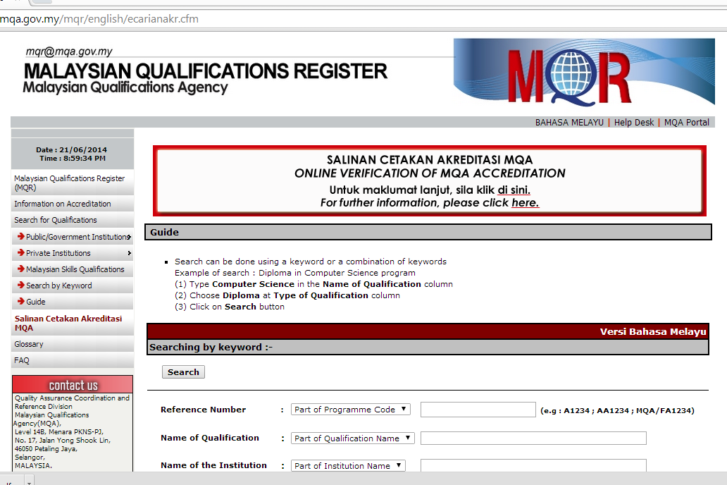

Slide 8
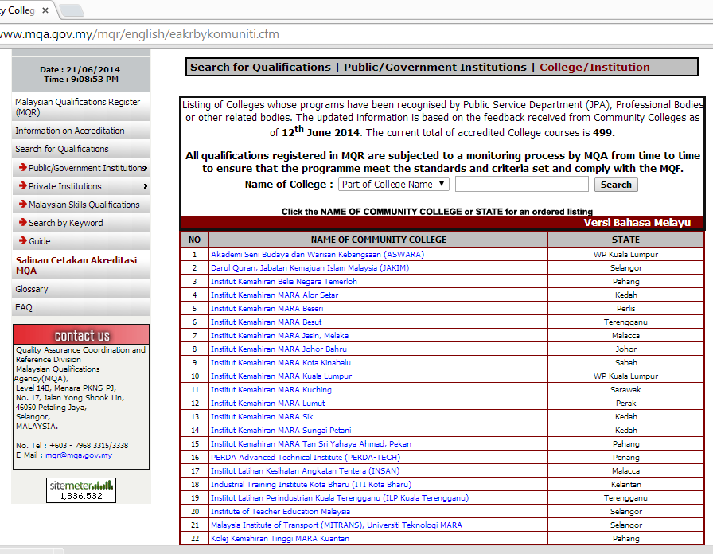

Slide 9
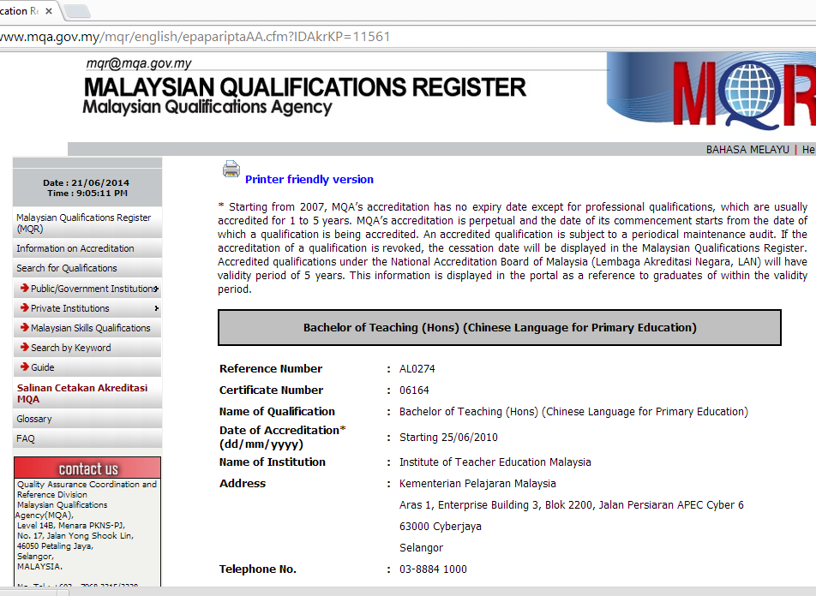

Slide 10
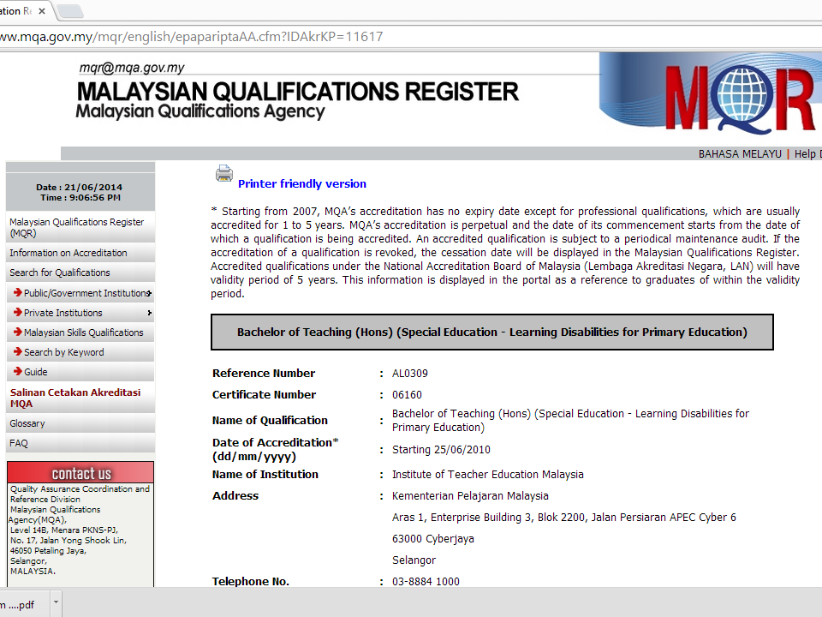

Slide 11
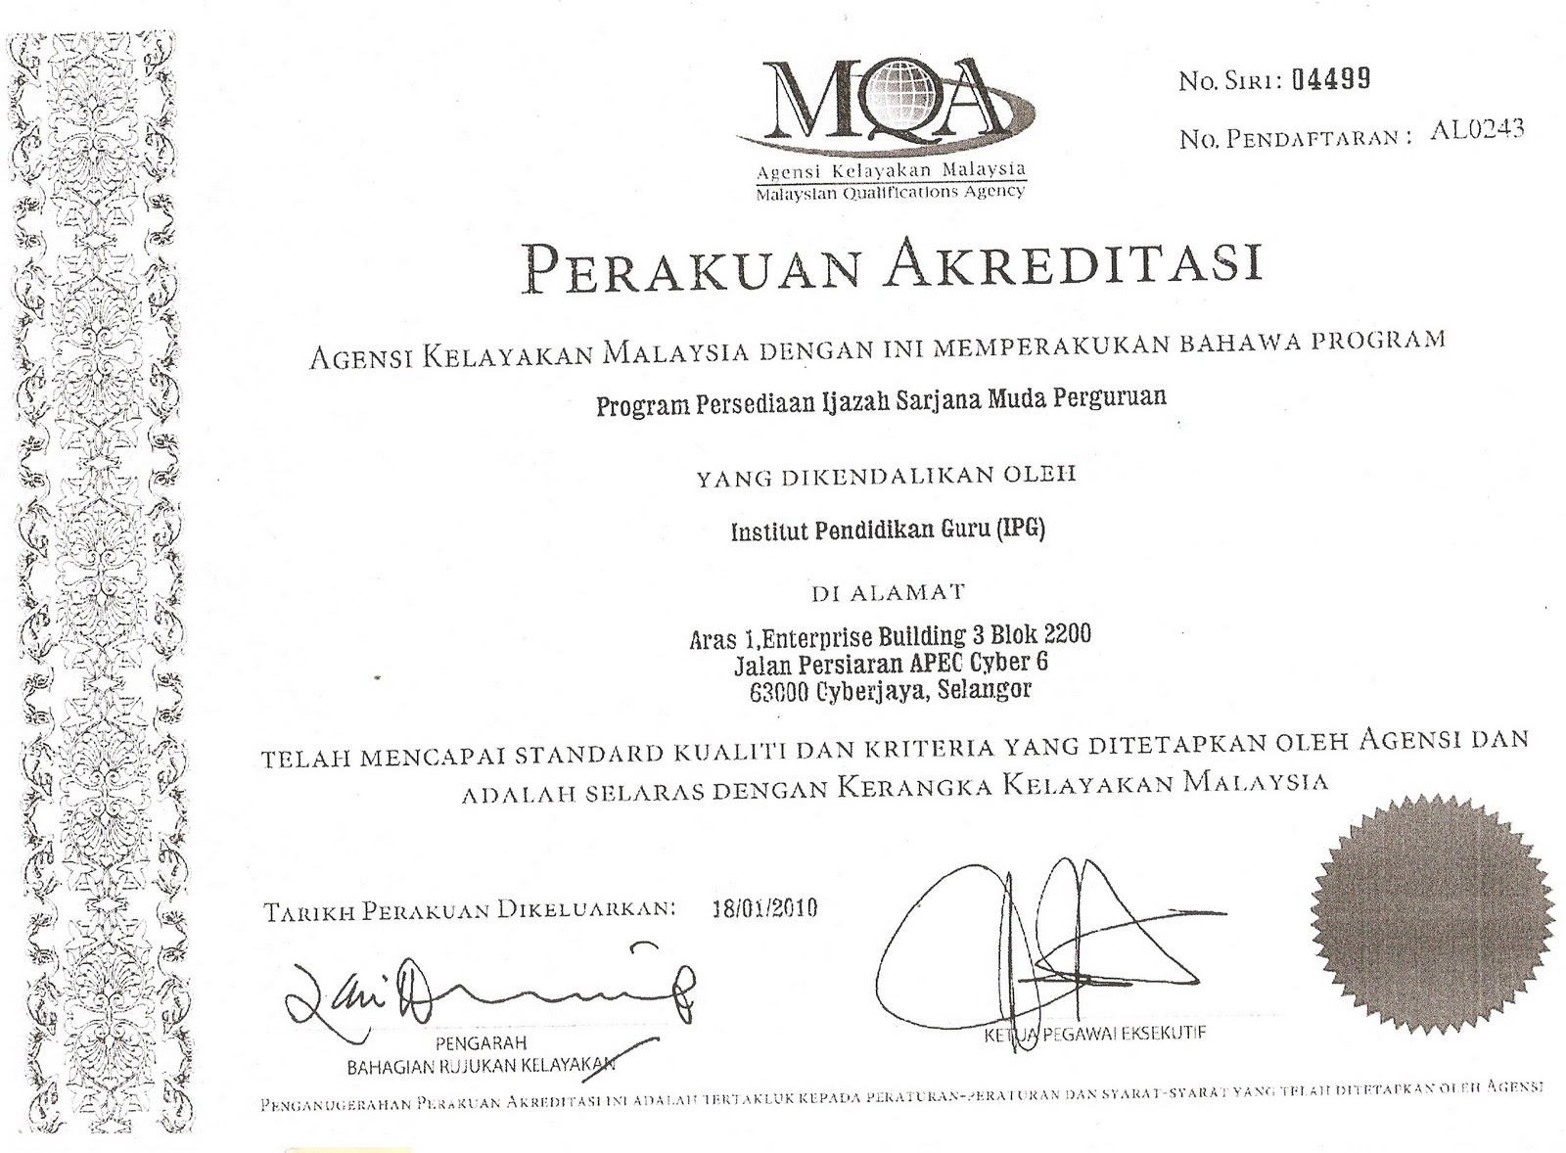

Slide 12
What is the MQF?
MQF* Para 1
MQF is an instrument that develops and classifies qualifications based on a set of criteria that is approved nationally and at par with international practices, and which clarifies the earned academic levels, learning outcomes of study areas and credit system based on student academic load.
* The Malaysian Qualifications Agency (2007), The Malaysian Qualifications Framework, Kuala Lumpur.

Slide 13
PROGRAM YANG TERLIBAT
PPG

Slide 14
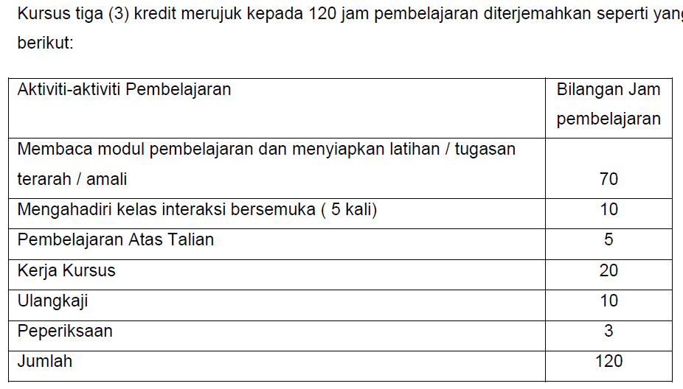
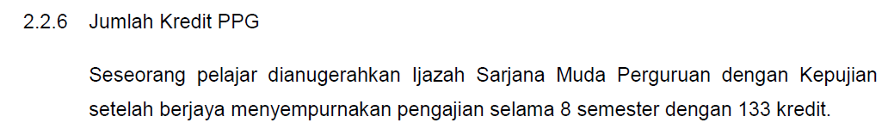

Slide 15
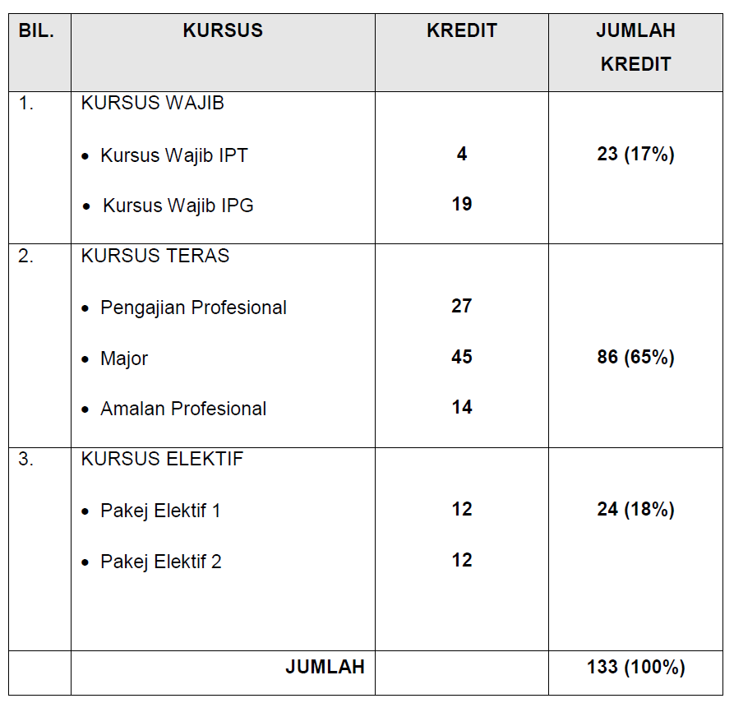

Slide 16
Life long
learning
QUALIFICATION LEVELS & PATHWAYS
LIFE LONG
LEARNING
UNIVERSITY
DOCTORAL
MASTERS
BACHELOR (HONS.)
MINISTRY OF
HUMAN
RESOURCE
ADVANVED
DIPLOMA
SKILLS
DIPLOMA
SKILLS
CERTIFICATE
POLYTECH,
NON DEGREE
GRANTING
COLLEGES,
UNIVERSITIES
ADVANCED
DIPLOMA
TECH & VOC
DIPLOMA
TECH & VOC
CERTIFICATE
P
P
P
T
a
t
a
u
A
P
E
L
8
POSTGRAD CERT.
& DIPLOMA
GRADUATE CERT.
& DIPLOMA
7
6
5
4
3
Learning
Outcomes
Credit system
HIGHER SCHOOL
CERTIFICATE;
FOUNDATION
MATRICULATION
2
1
SCHOOL
CERT

Slide 17
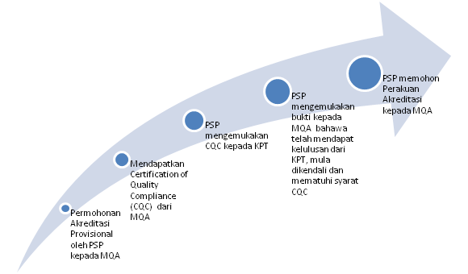
KEHENDAK MQF/MQA

Slide 18

KEHENDAK MQF ..
guide for providers of higher education, quality assurance assessors, officers of the MQA, policy makers, professional bodies and other stakeholders engaged in higher education
The Code of Practice for Programme Accreditation (COPPA)

Slide 19
The Code of Practice for Programme Accreditation (COPPA)
A document dedicated for the purpose of programme accreditation which uses the nine areas of evaluation to assist HEPs attain at least benchmarked standards for the said purpose and continuously improve the quality of the programme.
Contains benchmarked Standards and Enhanced Standards for the nine QA areas.

Slide 20
A credit the agreed-upon value used to measure a student workload in terms of learning time required to complete course units, resulting in learning outcomes’ (UNESCO, 2004)
Academic Load
Teaching Learning
Activities
Achievement of Learning Outcomes
Lecture
Project Work
Study Tour
Demonstration
Tutorial
Presentation
Case study
Assignments
Laboratory
Revision
E-Learning
Clinical
Teaching/Learning + Assessment
Work attachment
Studio work
Group Discussion
Group Assignment
Field Work
Research Project
Examination
Industrial training
Directed reading
e.g. 4 800 notional SLT = 120 credits
Total SLT
40
Credit
Student Learning Time (SLT)

Slide 21
General Principle 4: Learning Outcomes
(MQF Para 15) – LO Domains
1
2
3
Knowledge
Practical Skills
Social skills and responsibilities
4
5
Values, attitudes and professionalism
Communication, leadership and team skills
6
7
Problem solving and scientific skills
Information management and lifelong learning skills
8
Managerial and entrepreneurial skills

Slide 22
Learning
Outcomes
Credits
PSYCHOMOTOR/
PRACTICAL/
TECHNICAL
SKILLS
Life
Long
Learning &
Information Management
Communi
-cation
& team
skills
SOCIAL SKILLS &
RESPONSIBILITY
KNOWLEDGE
Critical
Thinking & Scientific Approach
Managerial & Entrepreneu
-rial
Skills
PROFESSIONALISM,
VALUES,
ATTITUDES,
ETHICS
QUALIFICATION DESCRIPTORS

Slide 23
1. Ilmu bidang (Knowledge)
Menunjukkan pengetahuan dan kefahaman prinsip-prinsip asas sesuatu bidang yang diperoleh daripada buku teks lanjutan dan di sempadan ilmu
Example of Student Response (outcomes)
recall/state items of facts & information;
discriminate among objects & events (concepts);
show relationships between concepts (principles)
Apply principles to new situations;
explain circumstances;
infer causes or effects;
predict outcomes

Slide 24
2. PSYCHOMOTOR/PRACTICAL/TECHNICAL SKILLS
Menunjukkan kepandaian melaksanakan tugas praktikal dan teknikal yang diperlukan dalam ilmu bidang (contohnya kemahiran makmal sains, kemahiran teknikal kejuruteraan, kemahiran klinikal, literasi komputer & instrumen IT lain)
Examples of Student response (outcomes)
Perform a blood smear test
Carry out first aid
use power point to prepare a presentation

Slide 25
3. SOCIAL SKILLS & RESPONSIBILITY
Menunjukkan kefahaman dan kepekaan kepada kepelbagaian dalam masyarakat dan bersedia bekerjasama memberi khidmat untuk mencapai matlamat bersama
Examples of student response (outcomes)
recall/state items of facts & information regarding the various cultural practices
Respect cultural diversity,& willing to address and solve social-cultural issues in the community
Participate actively in inter ethnic activities and community projects aimed at better inter cultural understanding & community development

Slide 26
4. PROFESSIONALISM, VALUES,
ATTITUDES, ETHICS
Dapat mengguna ilmu pengetahuan dan kefahaman dengan kaedah yang menunjukkan keprofesionalan dalam tugasan (kepentingan bersama & bukan peribadi), kepribadian yang murni dan pembuatan keputusan berlandaskan etika yang relevan
Examples of student response (outcomes)
Collaborate in learning group as a team, willing to acknowledge limitations, share knowledge & help others
Demonstrate commitment to excellence, confidentiality, honesty & integrity in Intellectual Property
Commitment to scientific methods & evidence-based decisions with ethical considerations (fair, objective, reliable, transparent)

Slide 27
5. SELF-DIRECTED LIFE LONG LEARNING & INFORMATION MANAGEMENT
Mempunyai teknik dan kebolehan mencari dan mengguna data untuk menambahbaik idea, menyelesai masalah dan membuat keputusan tertentu serta mempunyai kemahiran belajar untuk meneruskan pengajian lanjutan dengan autonomi yang tinggi.
Examples of student response (outcomes)
Able to set reasonable learning objectives
Able to use library & ICT to:
  Search for information
  Keep organised records of best/good practices;
  retrieve information easily for reference
  Keep directory of “best” sources of particular types of information
Able to teach others & to give & receive feedback

Slide 28
6. CRITICAL THINKING & RESEARCH METHOD
Mempamerkan kaedah saintifik dalam proses pemikiran untuk menyelesai masalah dalam bidang
Examples of student respone (outcome)
Able to apply problem-solving process in learning:
  Generate hypotheses
  Ask the relevant questions
  Identify gaps in own knowledge, skills & values
  Identify type & sources of information
  Seek & collect data & new information
  Critically evaluate new information (evidence-based)
  Synthesise data from different sources & apply probability theory to refine hypotheses

Slide 29
7. COMMUNICATION SKILLS
Cekap berkomunikasi dan dapat menyampaikan maklumat, idea, masalah dan penyelesaian kepada pakar dan bukan pakar serta mempunyai kemahiran berpasukan, kepimpinan dan interpersonal yang bersesuaian dengan pekerjaan
Examples of studetn response (outcomes)
Demonstrate group process skills in class and other activities
  listening, speaking, teaching, giving & receiving feedback, teamwork, respect differences in opinion
Able to use BM & English correctly in
  conducting a conversation, taking note of verbal & non verbal cues
  Synthesising information & writing essays & other assignments
  Making a presentation of ideas to expert & non expert audience

Slide 30
8. MANAGERIAL & ENTREPRENEURIAL
Dapat mengguna prinsip pengurusan & perniagaan untuk memulakan keusahawan sendiri dan cekap mengurus masa dan diri untuk meghadapi cabaran
Examples of student response (outcome)
Able to prepare a business plan
Participate actively in student entrepreneurship activities
Able to lead a student organisation or student activity
Able to self-care, manage time & cope with stress

Slide 31
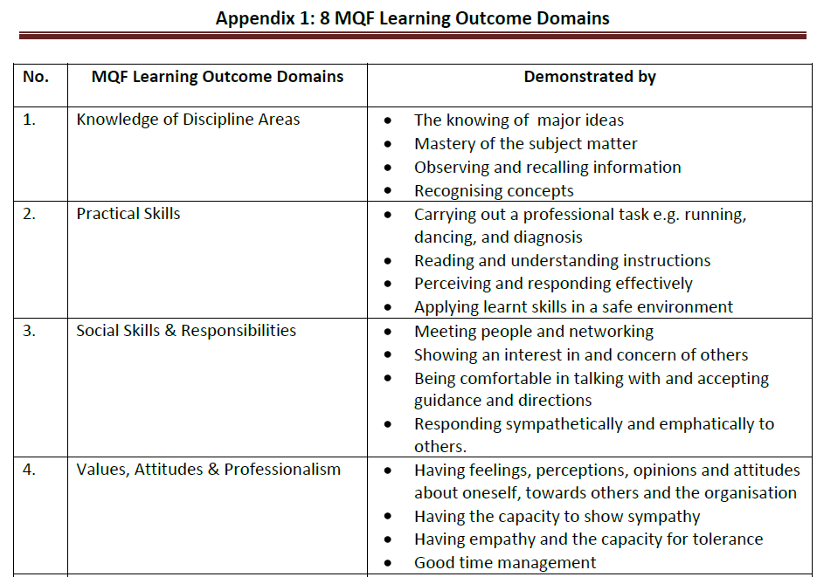

Slide 32
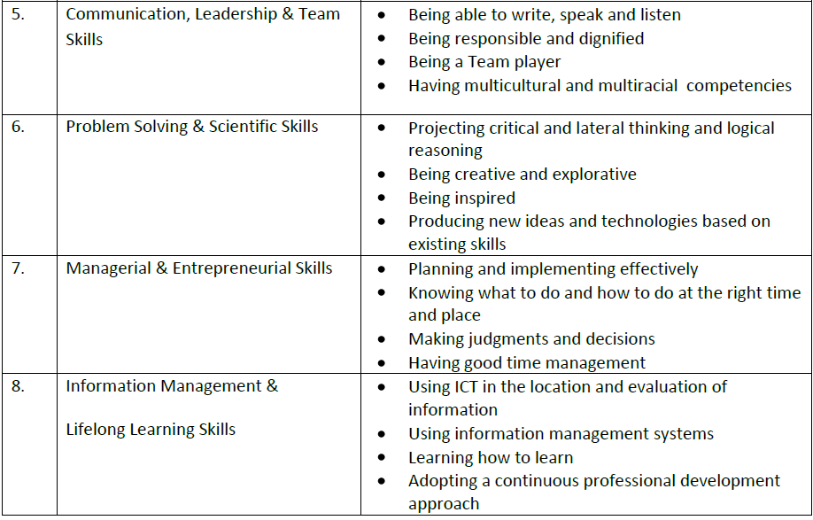

Slide 33
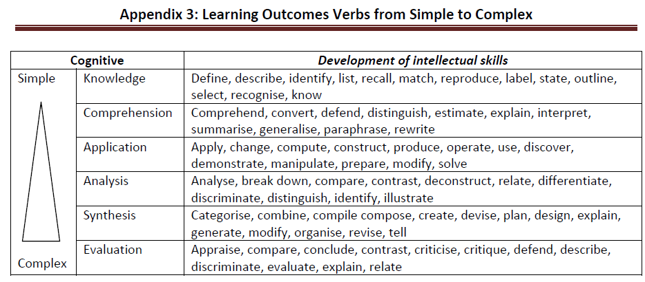

Slide 34
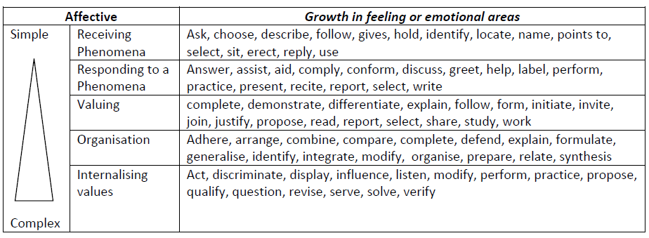

Slide 35
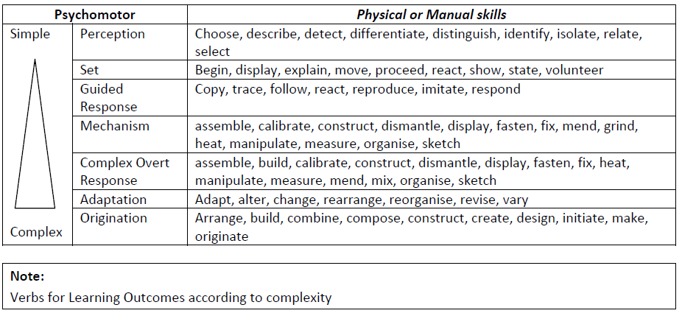

Slide 36
Kod Amalan Jaminan Kualiti
9 Aspek - Kriteria & Standard
Visi, Misi,
& matlamat institusi, hasil pembelajaran
Reka bentuk dan penyampaian Program
Pemilihan dan khidmat sokongan kepada pelajar
Sistem penilaian pelajar
Kakitangan akademik
Sumber
Pendidikan
Pemantauan dan semakan semula Program
Kepemimpinan, governans dan pentadbiran
Penambahbaikan
kualiti berterusan
secara menyeluruh

Slide 37
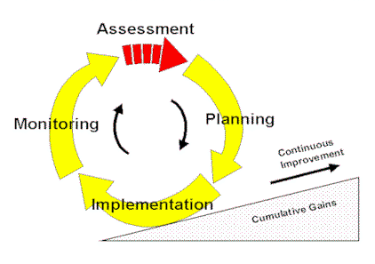
QA REQUIRMENTS IN A NUTSHELL
PROGRAMME ACCREDITATION
KEPIMPINAN, GOVERNAN DAN PENTADBIRAN (8)
KEPERLUAN PIHAK YANG BERKEPENTINGAN
VISI, MISI, MATLAMAT PEND. DAN HASIL PEMBELAJARAN (1)
PEMANTAUAN & SEMAKAN PROGRAM (7)
SUMBER PENDIDIKAN (6)
REKABENTUK KURIKULUM (2a)
STAF AKADEMIK (5)
KEPUASAN PIHAK YANG BERKEPENTINGAN
INPUT (PELAJAR)
PENILAIAN PELAJAR (3)
OUTPUT (GRADUAN)
PENYAMPAIAN (2b)
PEMILIHAN (4a)
KHIDMAT SOKONGAN (4a)
MAKLUM BALAS PIHAK BERKEPENTINGAN
PENAMBAH BAIKAN BERTERUSAN (9)

Slide 38
BASIC STANDARD
V, M, LO & Processes
must be defined
by stakeholders
Vision,
Mission,
Institutional goals
& learning
outcomes
Ethics & Professionalism
Entrepreneurship/
intrepreneurship &
management
Must have autonomy
to design curriculum
incl across faculties;
allocate resources
Communication Skills
Mastery of Knowledge
Critical thinking
Practical Skills
Working
in teams
Problem Solving
LLL

Slide 39
QUALITY DEVELOPMENT
Vision,
Mission,
Institutional goals
& learning
outcomes
V, M, LO & Processes: in consultation with
wider range of
stakeholders
Links bet Lo of undergraduate
& Postgraduate training
LLL
All academic staff focused on curriculum development
& implementation
Policy on
conflict of interest
resources = educational needs

Slide 40
BASIC STANDARD
Must have program head & team to plan,
implement, monitor, adequate resources
Identify aspects in ethics,
effective communications to
incorporate into curriculum
Demonstrate curriculum
approach, design content,
T & L methods support LO
CURRICULUM
DESIGN
&
DELIVERY
Must use accepted credit system; allocate adequate time
Must have variety of T & L
methods to dev range of
intellectual & practical skills
Must ensure student
responsibility for learning:
self directed, LLL
Must teach scientific method:
analytical, critical, creative thinking prob solv, evid based decision making
Operational linkages
w stakeholders
Must identify core, fulfill req
for major/minor
Electives must be encouraged,
monitored, & appraised.
Co-curr foster personal dev.

Slide 41
QUALITY DEVELOPMENT
Curriculum
should encourage
personal development
CURRICULUM
DESIGN
&
DELIVERY
Program management
should include wider range
of stakeholders
Integrate theory
with practice
Should use tracer
studies of graduates
for curr improvement
Emphasis should be
on basic principles
Curriculum should include
rational thinking &
research methodology
Should review &
update core

Slide 42
BASIC STANDARD
Must document student
assessment: frequency,
methods, pass/fail criteria
on commencement
of program
Must ensure validity,
reliability & security
& fairness of exam
system
ASSESSMENT
OF
STUDENTS
Balance bet summative
& formative assessment
Assessment clearly reflect
program LO & content;
promote learning

Slide 43
QUALITY DEVELOPMENT
Should evaluate &
document reliability
& validity of all
assessment methods;
review methods
Program management
team should review/ new
assessment methods
ASSESSMENT
OF
STUDENTS
Should encourage
participation by
external examiners
Assessment of
excessive amounts
of factual into should be
reduced to decrease
curriculum overload
Should review assessment
system & methods with
feedback from students

Slide 44
ASSESSMENT

Slide 45
Self Study : Student Assessment
1. Articulating Student Learning Outcomes
2. Connecting the Outcomes to the Curriculum
3. Connecting Outcomes with Assessment Methods
Articulating your Expected Results with Respect to the
Outcomes
5. Articulating the Assessment Plan for Gathering the Data
6. Collecting & Analyzing the Data
7. Comparing Actual Results with Expected Results
8. Using Results for Improvement

Slide 46
STUDENT SELECTION
& SUPPORT

Slide 47
BASIC STANDARD
Must have a published
admission policy
distributed to students
Must have policy on
student representation
STUDENT
SELECTION
&
SUPPORT
SERVICES
Must have student support services incl counseling
Pre-requisite knowledge
& skills must be clearly
stated
If interviews conducted,
must be objective & fair
Must provide criteria &
mechanisms for students who wish to transfer
Must have clear
mechanism for appeal
Must state size of student
intake/session
Degree granting HEI is
responsible for selecting &
assigning students to branch
campuses

Slide 48
QUALITY DEVELOPMENT
Should encourage student
organisations to facilitate
experience in governance
& social activities
Should review
admission policy
STUDENT
SELECTION
&
SUPPORT
SERVICES
Monitor student
performance to
improve
Counselling should be based on monitoring of
students progress
Should provide
bridging programs
when necessary
Size of student intake should
be reviewed in consultation
with stakeholders to
meet needs of society

Slide 49
BASIC STANDARD
Must have clear
recruitment
policy of teachers
Must ensure validity, reliability
& security & fairness of exam
system
ACADEMIC
STAFF
Must recognise meritorious roles with
appropriate rewards
of promotion or salary
increme
Appropriate staff to
student ratio must be
identified; minimum
staff number for program must
be determined
Staff policy must address service
matters, development, appraisal,
core roles of teaching, research,
consultancy, admin, community
service

Slide 50
QUALITY DEVELOPMENT
Should seek balance
between senior & junior
staff,full & part-time staff
ACADEMIC
STAFF
Staff appraisal
should take into account
professional, academic &
community service
Staff development
must be provided & mentoring of new staff
Staff development must be provided & mentoring of new
staff

Slide 51
6 Standards & Criteria
BASIC Sufficient & appropriate physical facilities for staff & students for effective delivery of curriculum; practical-based facilities for training; special needs-friendly Library: adequate collection of up-to-date reference material; staffed by qualified librarians Policy on selection, use of ICT coord with library; with infrastructure & human resource Policy fostering research & education; starting research priorities Policy on use of educational expertise Policy of collaboration with educational institutions Budgetary & procurement policies with clear line of responsibility & authority Tuition assurance policy | QUALITY DEV Should regularly improve learning environment & renew physical facilities Training in ICT for LLL Interaction of research & education should be reflected in the curriculum, influence teaching, encourage research, link with commercialisation Access & use of educational experts Staff & student exchange programs Faculty deans & heads of programs should have autonomy to allocate resources & achieve program goals
Educational
Resources

Slide 52
7 Standards & Criteria
BASIC Must establish mechanisms & resources for program evaluation, monitoring Must provide institutional data for educational experts to review; feedback channeled back to program developers Must ensure matters of concern are addressed Student & staff feedback must be actively sought Student performance must be analysed in relation to mission & LO Governance & administration must be evaluated Professional bodies must be involved in program evaluation of professional programs | QUALITY DEV Program evaluation should address structure & process of programs Students & staff should be involved in planning program evaluation; available channels for student feedback Student performance analysed based on entry qualifications Industry should be invited to evaluate programs A range of stakeholders should have excess to results of program evaluation
Program
Monitoring
& Review

Slide 53
BASIC STANDARD
Must have constructive
& proactive mechanism
for corporation w
stakeholders
Must define structure,
function of HEI;
LEADERSHIP,
GOVERNANCE
ADMINISTRATION
Management
based on transparency,
equality, objectivity;
accountability
Must clearly state
responsibilities
of academic
leadership
Must have appropriate
authority over curriculum
Admin staff must be
sufficient to support
program

Slide 54
QUALITY DEVELOPMENT
Governance should
set committee structure
for educational programs
Formalise collaboration
with external sectors via MOU
LEADERSHIP,
GOVERNANCE
ADMINISTRATION
Academic leadership
should be evaluated
at intervals
Management
should establish a
Quality Assurance
program

Slide 55
BASIC STANDARD
TOTAL
CONTINUAL
QUALITY
IMPROVEMENT
Must rectify
documented
deficiencies
HEI must establish
dynamic policies,
procedures & mechanisms
for regular reviewing
& updating
of structure, functions,
strategies & core activities

Slide 56
QUALITY DEVELOPMENT
TOTAL
CONTINUAL
QUALITY
IMPROVEMENT
Should lead to revision of policies & practices
of the HEI in accordance
with past experience
present activities
& future perspectives
Continual
improvement
should be based on
prospective studies
& analyses

Slide 57
Maklumat program
1. Bagaimana dengan Struktur Program?
e.g PISMP dengan kepujian dilaksanakan selama 4 tahun (8 Semester)
Satu Tahun dibahagi kepada dua Semester
Setiap Semester mengandungi 18 minggi (15 interaksi, 1 ulangkaji, 2 peperiksaan)
2. Bagaimana jam kredit dikira?
40 Jam Pembelajaran (Notional hours) = 1 kredit (termasuk Kokurikulum dan BIG – 40 jam = 1 kredit
Amalan Profesional (Praktikum dan Internship) – dua minggu = 1 kredit
Jumlah - 133 kredit
3. Apakah kerangka dan komponen Kurikulum?
Rujuk Buku Panduan PPG

Slide 58
4. Bagaimana penilaian dan penaksiran dibuat?
Penilaian dalam bentuk penaksiran berterusan, Ujian akhir kursus dan peperiksaan.
3 aras kesukaran – kefahaman, analisis dan sintesis
Purata Nilai Gred Kumulatif (PNGK) dikira berdasarkan PMG setiap semester

Slide 59
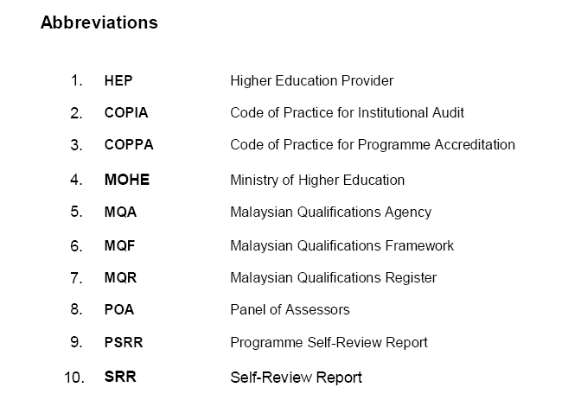
M/Surat XI

Slide 60
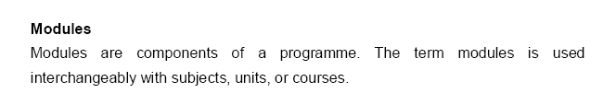
M/Surat IX

Slide 61
TERIMA KASIH

